Slide 1
Sentweet- Twitter Analysis

Slide 2
TEAM MEMBERS
1.Mohammed Asra Fatima
E-mail : fatima07asra@gmail.com
2.Sabrina Shaik
E-mail : sabrina.shaik80@gmail.com
3.Rohit Kumar Mudiraj
E-mail : rohitkumar143@gmail.com

Slide 3
Problem Statement:
The problem statement of Tweets Sentimental analysis is classifying the polarity of a given text at the document , sentence, or feature/aspect level whether the expressed opinion in a document, a sentence or an entity feature/aspect is positive ,negative , or neutral
To implement an algorithm for automatic classification of text into positive, negative or neutral.
Sentiment Analysis to determine the attitude of the mass is positive, negative or neutral towards the subject of interest.
Graphical representation of the sentiment in form of Bar Graph.

Slide 4
APPLICATIONS
Applications to Review-Related Websites-Movie Reviews, Product Reviews etc.
Applications as a Sub-Component Technology-Detecting antagonistic, heated language in mails, spam detection, context sensitive information detection etc.
Applications in Business and Government Intelligence-Knowing Consumer attitudes and trends
Applications across Different Domains-Knowing public opinions for political leaders or their notions about rules and regulations in place etc.

Slide 5
Technology Stack
Languages: Python3.7 for backend
HTML for front end
Libraries: TextBlob, Tweepy, Matplotlib
Web framework: Flask
System Requirements
HTML, JavaScript
Python
Twitter API keys
Flask

Slide 6
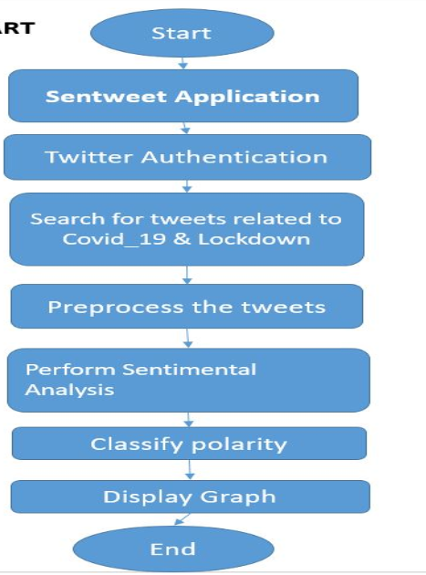
Procedure
Searching for the Data: Taking input form the user.
Text Preprocessing: Removing special characters and common Stop words.
Calculating polarity: Calculating how positive ,strongly positive, weakly positive, negative, strongly negative, weakly negative, neutral the tweets are.
Predicting Emotions and displaying in a bar graph: Done with the emotion annotated dataset “emotions.txt”

Slide 7
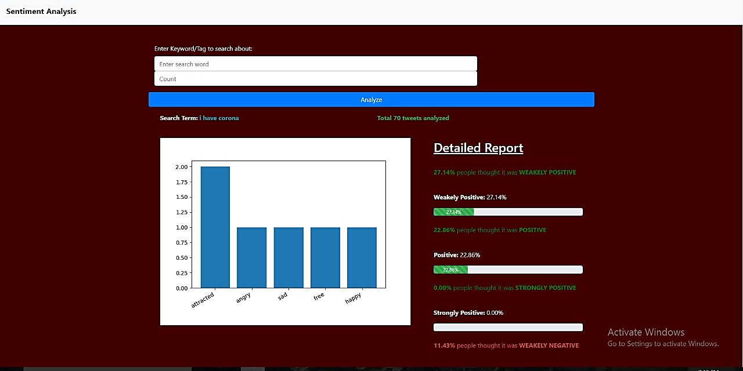

Slide 8
THANK YOU

